Slide 1
LEAD-ACID battery charger
Instructor : Mr. Yasiru Senarath
Group 08 - TEAM MetraWave
Meemanage M. A.
Anjula M. K.
Perera L.C.S.
Uduwaka S.S.

Slide 2
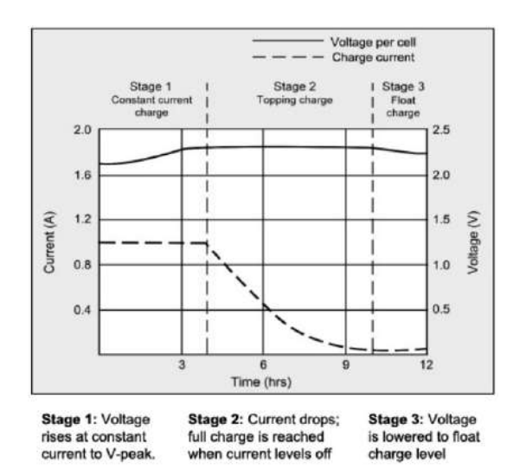
INTRODUCTION
Each battery has their own charging profile. In order to maintain a healthy battery, this charging profile should be followed correctly. Normally, this charging profile is comprised of constant current charging followed by a constant voltage stage. In this project we have to design a power source which can operate in both conditions.
The project introduction here is to design a constant current source to charge a 12v Lead acid battery, with a maximum charging current of 1A while getting the input voltage to the whole implementation as 230V (50Hz) AC source.
The whole analogy is based on the PWM technique.
Charging profile of a
lead-acid battery

Slide 3
PLAN FOR PRODUCT LAUNCH
Finishing the final product with all implementations.
PROBLEM Identification
A lead-acid battery charger to charge the battery in both modes constant current and constant voltage.
FINAL SIMULATION
The final simulation is done after designing it using the LTSpice software.
IMPLEMENTATION and Schematic
After finalizing the circuit diagrams with the aid of final simulation results, the breadboard implementation is done.
Designing and printing the enclosure using the software ‘SOLIDWORKS’ and finalize the PCB using ‘ALTIUM designer’.
LAUNCH
SOLIDWORKS Design and PCB

Slide 4
Functional block diagram
Power Supply
DC supply
230V AC source
Stepdown
Smoothing and rectifying
PWM Generator
Astable Multivibrator
Buck Converter
Comparator
Constant Current - CC
Switching circuit
Constant Voltage - CV

Slide 5
Main components used
741UA OPAMP IC
NE555P timer IC
TL084 IC
LM393P Comparator OPAMP IC
Inductor
Capacitors
Resistors
Mosfet (IRFZ44N) – high drain current and fast switching speed
Zenar regulators (15v)
Transistors

Slide 6
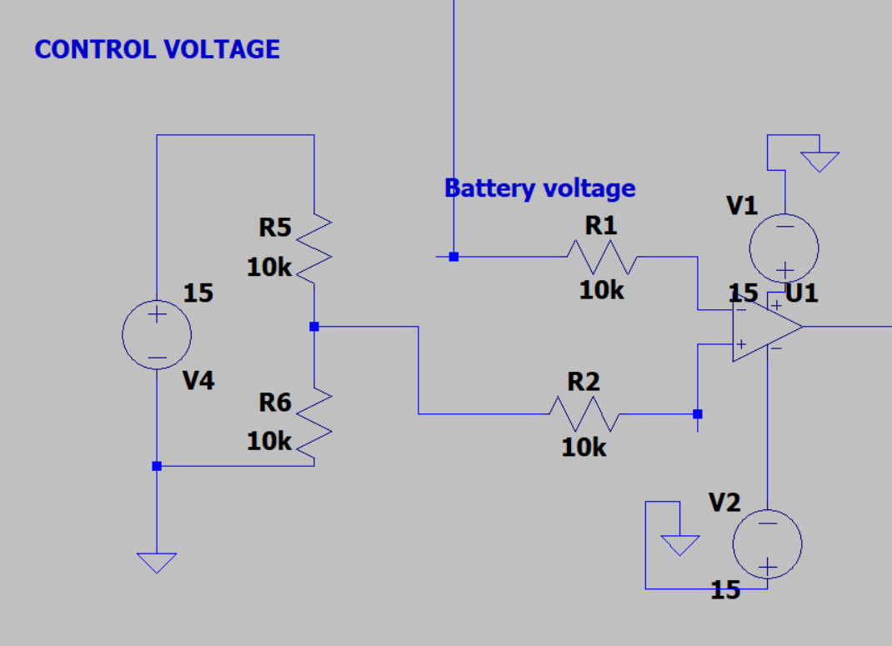
Constant voltage - CV
Unity gain amplifier of the buck converter
Astable multibibrator

Slide 7
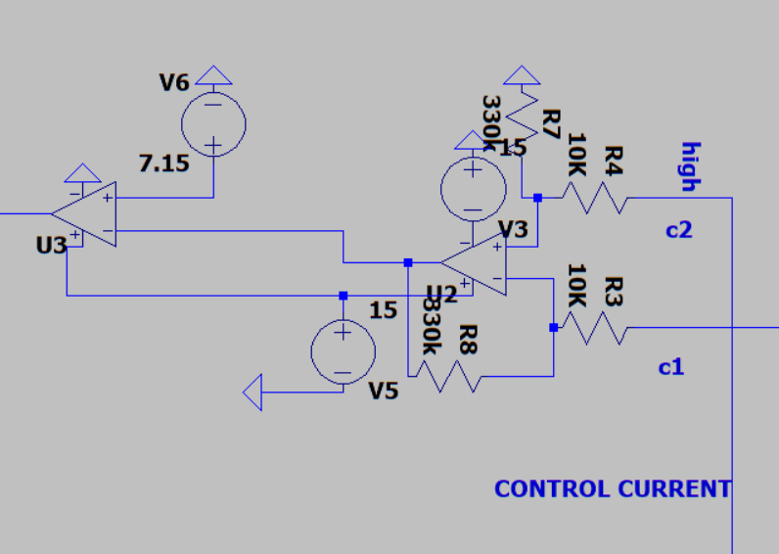
Constant Current - CC
Astable multivibrator

Slide 8
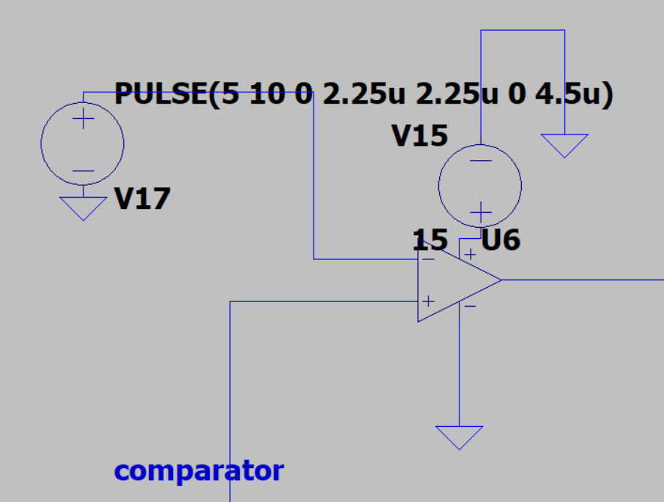
PWM Generator
Astable Multivibrator with Integrator

Slide 9
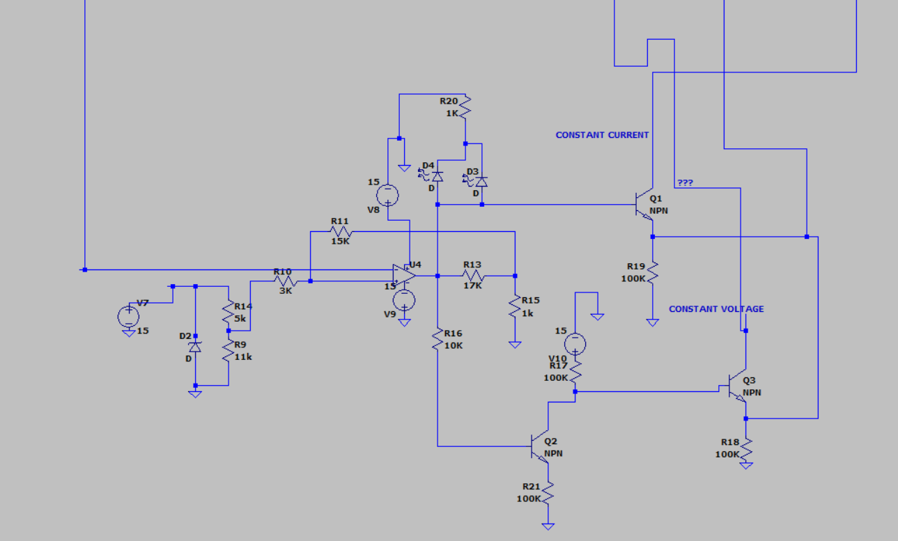
Switching circuit
PWM

Slide 10
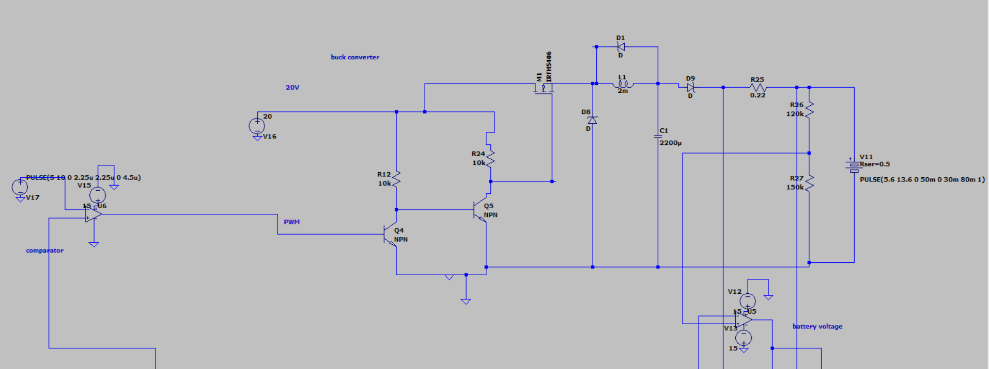
Buck converter
Switching circuit

Slide 11
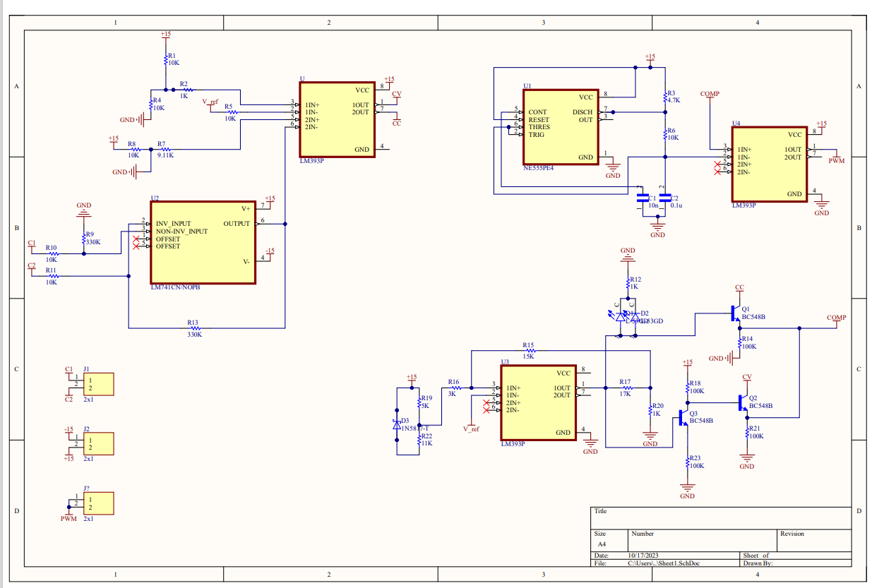
SCHEMATIC DIAGRAM

Slide 12
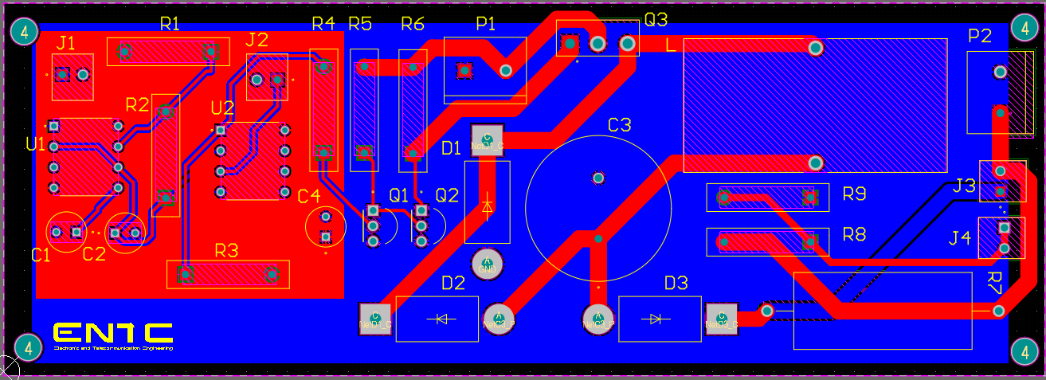
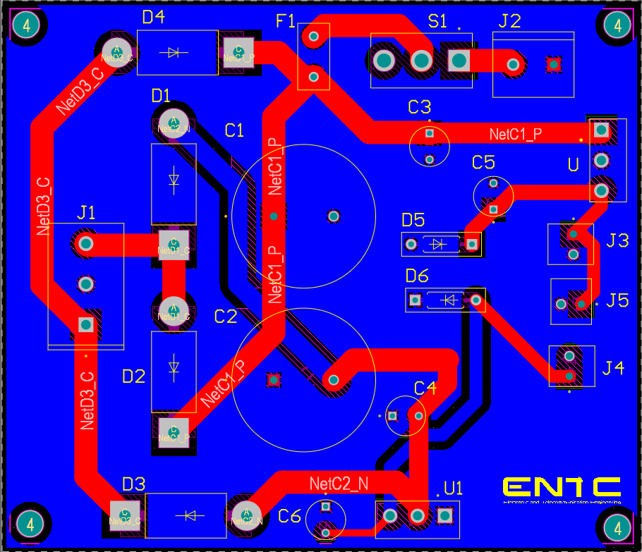
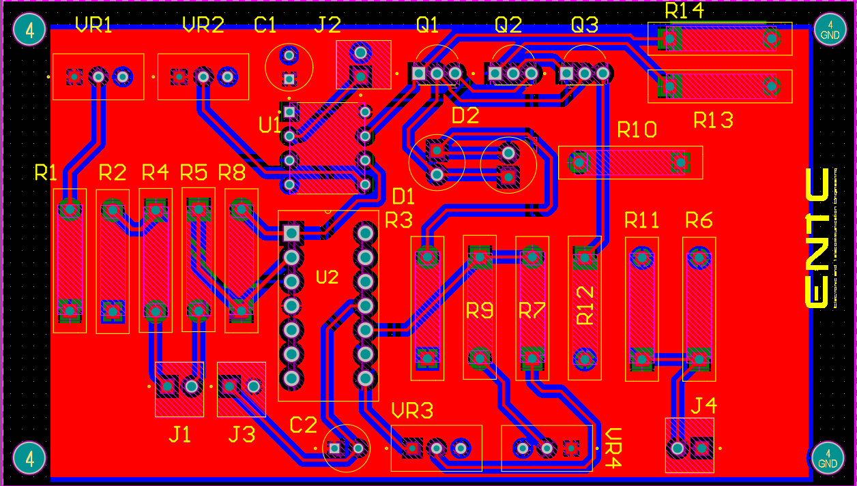
PCB DEsign
PWM and Buck Convertor circuit
Power Supply circuit
Switching, Constant current and Constant Voltage circuit

Slide 13
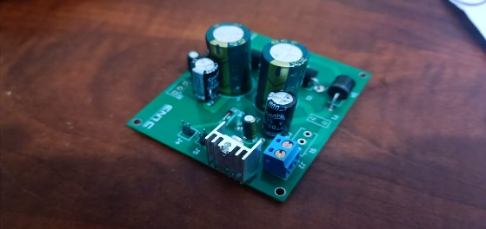
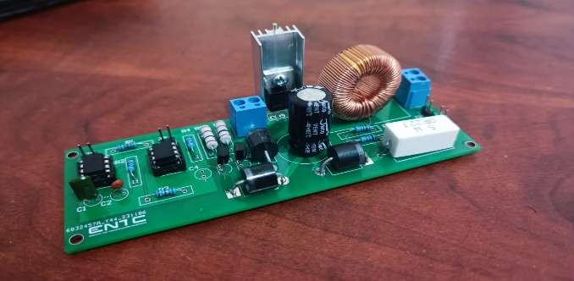
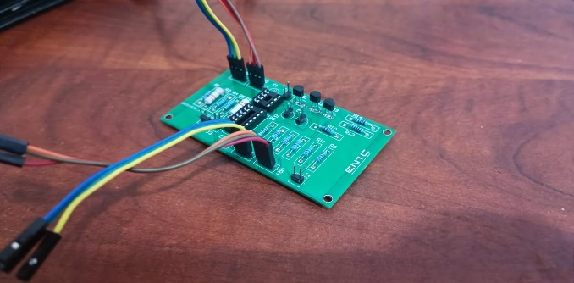
Soldered pcbs
Power Supply circuit
PWM and Buck Convertor circuit
Switching, Constant current and Constant Voltage circuit

Slide 14
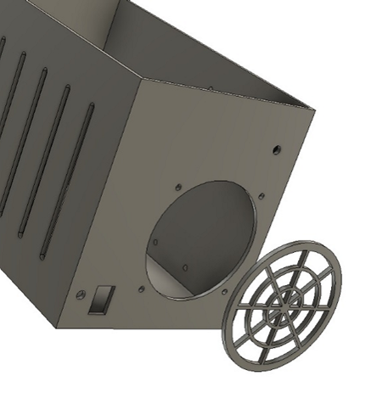
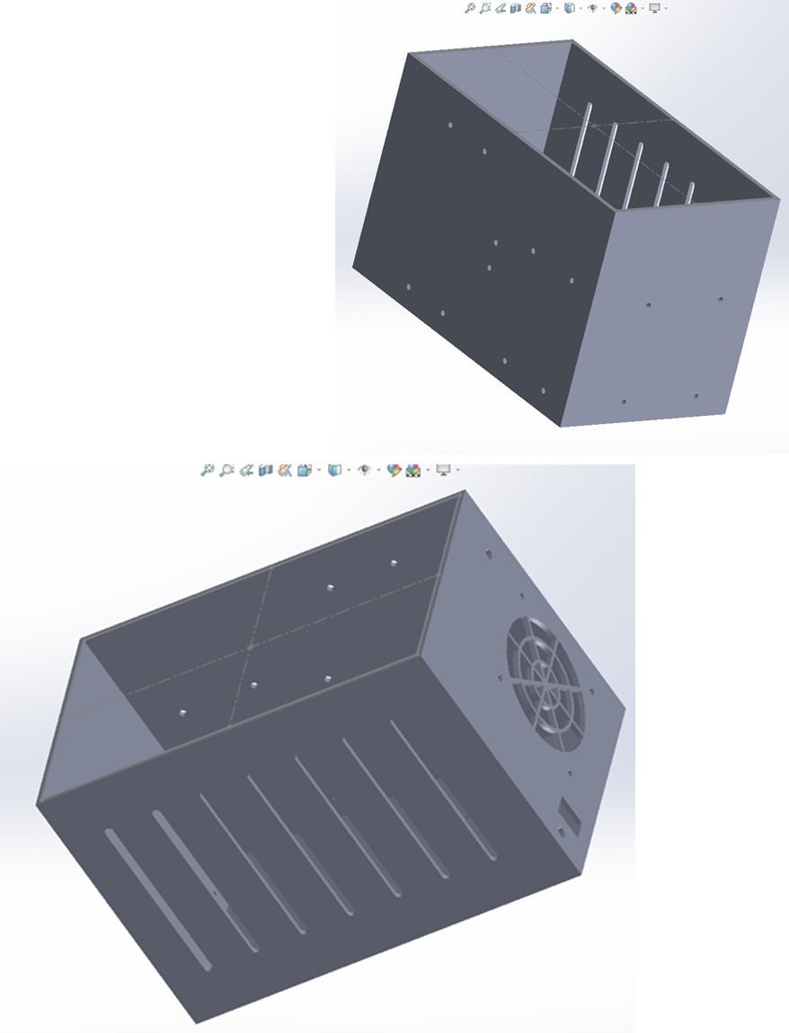
ENCLosure
The enclosure for the Lead-Acid battery charger is a simple hollow cuboidal structure designed using SOLIDWORKS designing software. With calculations done, initial sketches were drawn using the online version of AutoCAD software.
The outer dimension of the enclosure is 24.3cm X 14.2cm X 16.2cm, while a thickness of 3mm was also kept for the box.
Separate faces of the box has designed uniquely for separate tasks.
1. Bottom face – Transformer
2. Top face – connected with lid
3. Front face – Fan and switch
4. Back face – power supply
5. Right face – two PCBs including buck converter
6. Left face - Vents

Slide 15
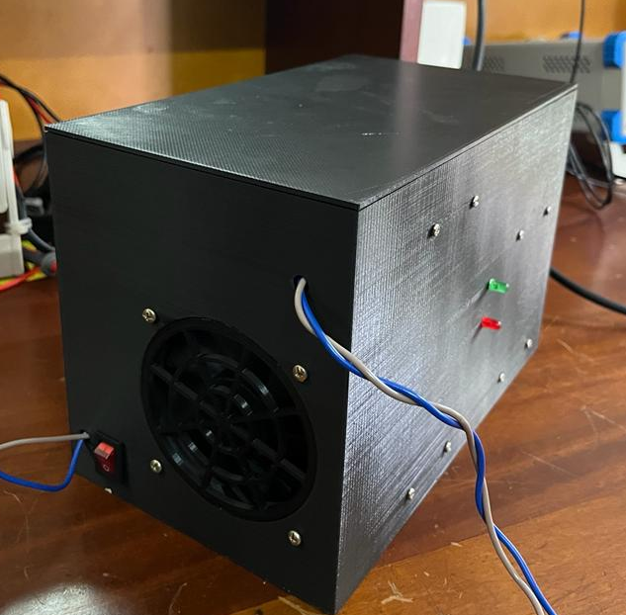
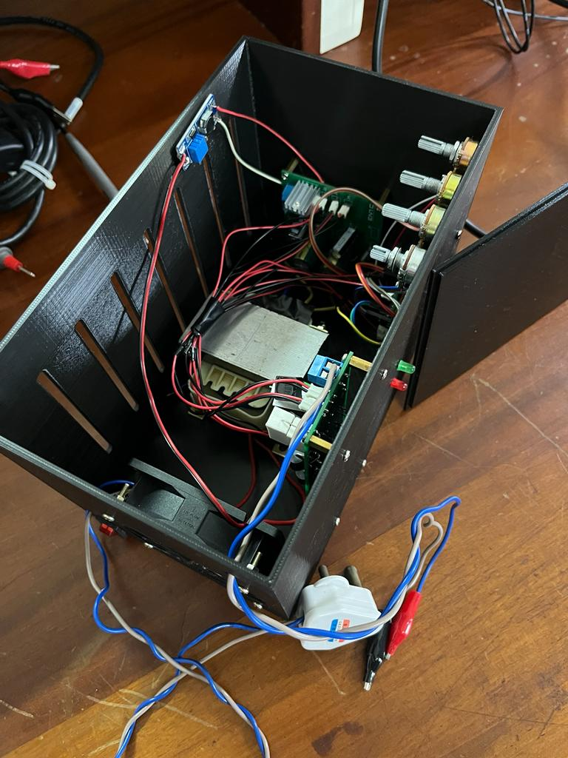
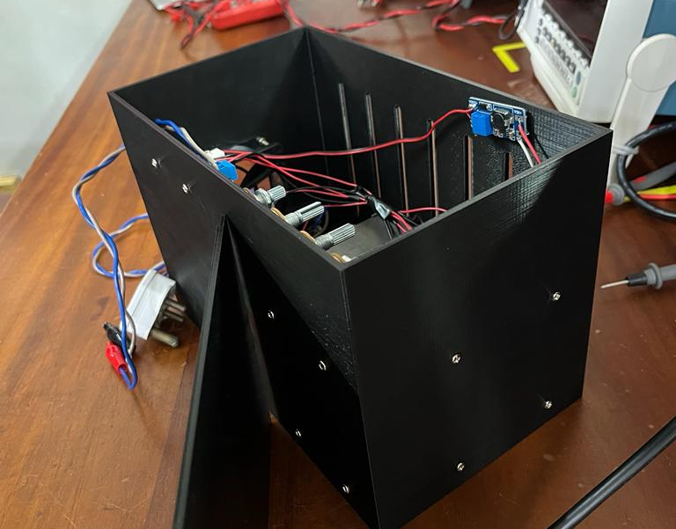
END product

Slide 16
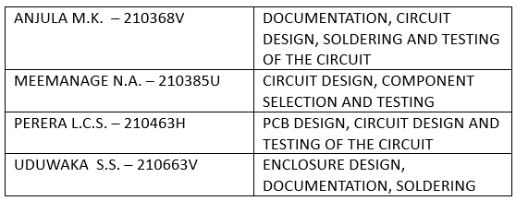
Task allocation

Slide 17




MEET OUR TEAM
THANK YOU
Meemanage M. A.
Anjula M. K.
Uduwaka S. S.
Perera L. C. S.
210385U
210368V
210663V
210463H

